Slide 1
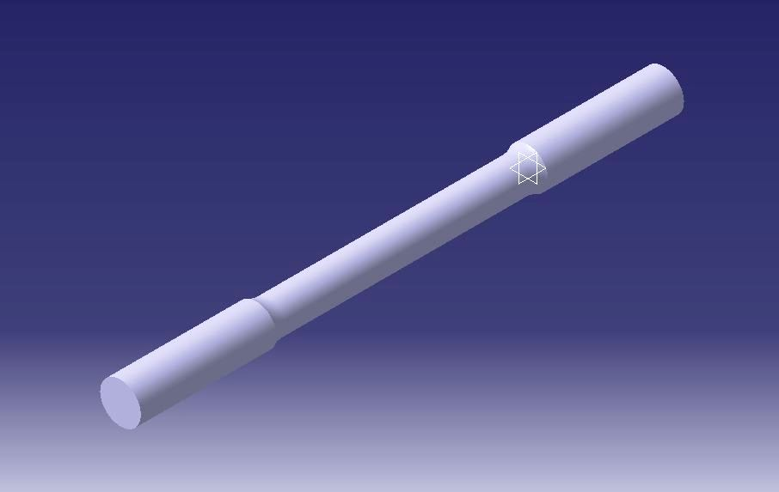
Tensile Test Samples
Cad Model

Slide 2
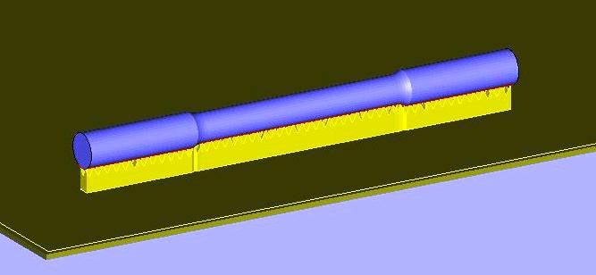
Support generation By Magics

Slide 3
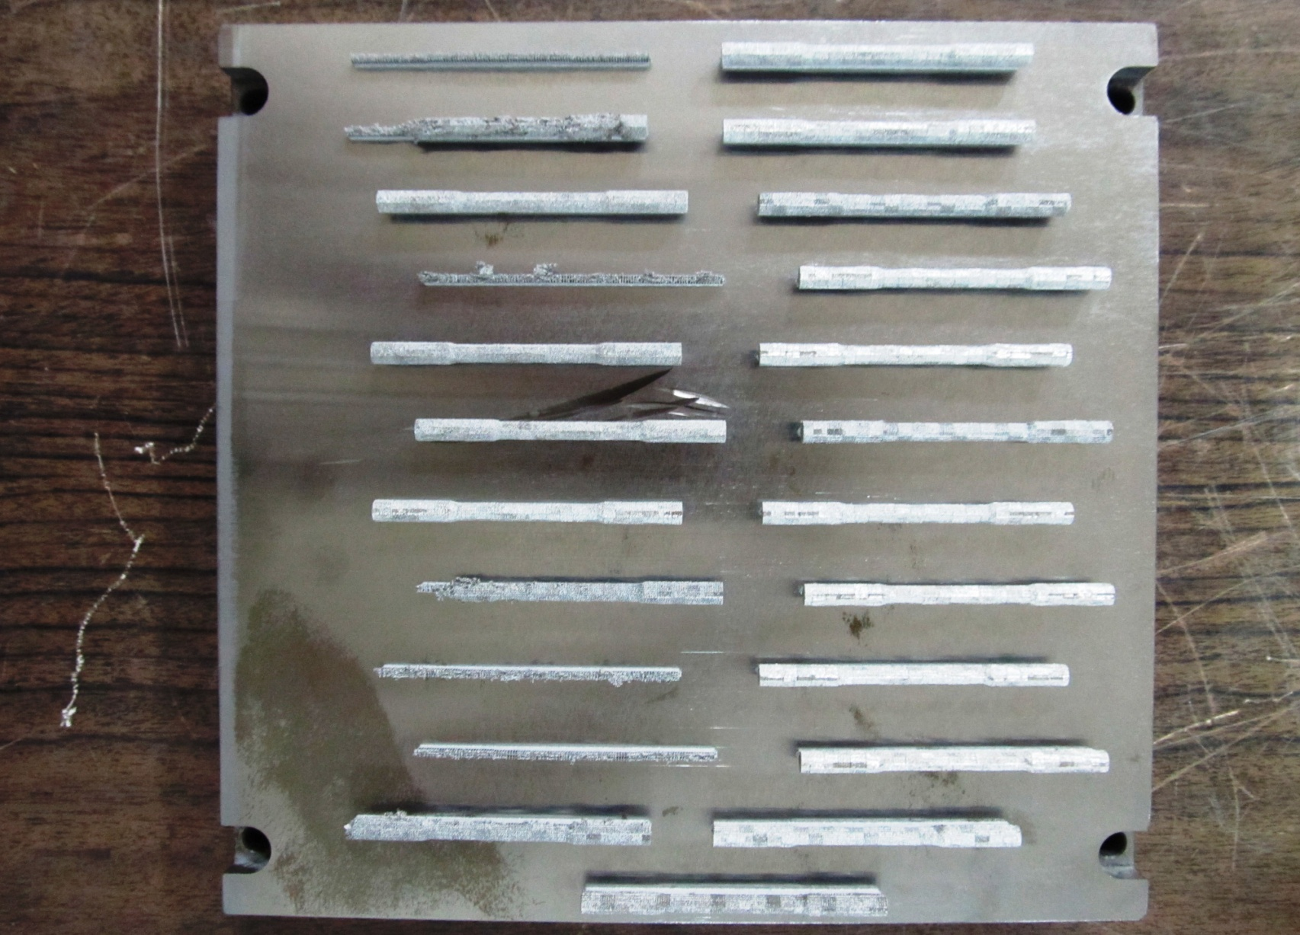
Sample on Platform

Slide 4
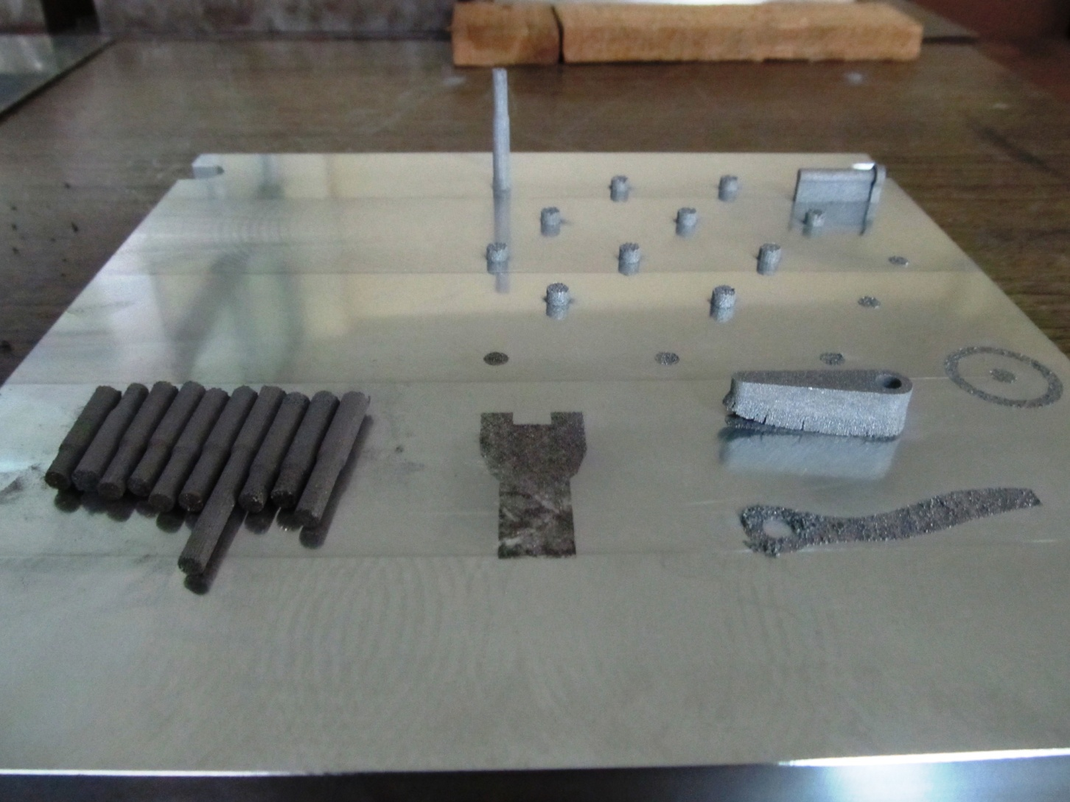
Defective Samples Made By vertically

Slide 5
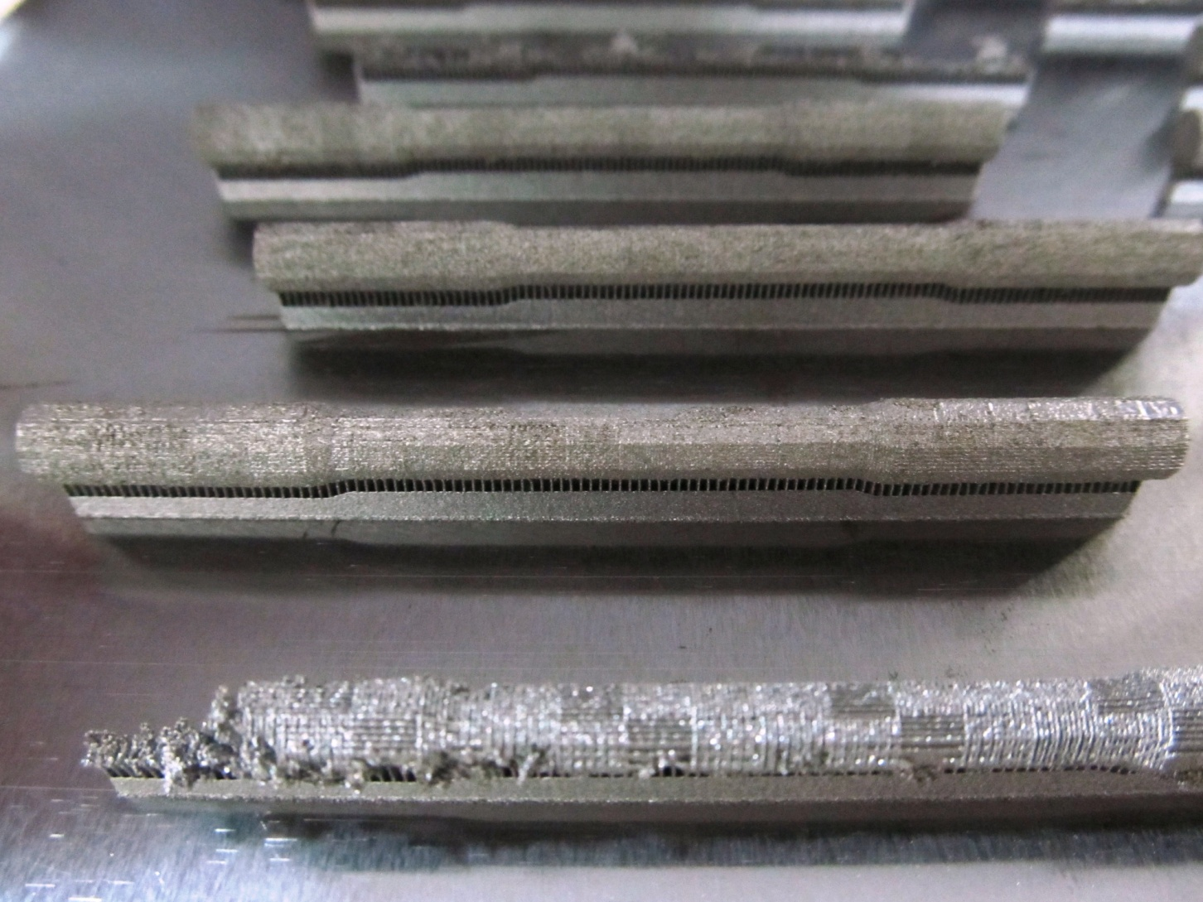
Defects On Samples

